Slide 1



Delivery Excellence
– Fueling Teams to Hyper speed
Behavior Driven Development
Building Shared Understanding

Slide 2

History
2006:
Dan North realized that replacing word “test” with word “behavior” helped developers concentrate more on the product
BDD filled in the gap the TDD was missing by linking test case to scenario.
Notes:
Is an agile approach of delivering software that has been gaining momentum of the past 10 years or so.
BDD/ATDD/Specification by Example
Continuing challenge is to determine whether or not software satisfies the requirements.
That brought about change to the way we deliver software and switch from a waterfall methodology with a slower feedback loop to agile methodology, with a faster feedback loop. In order to get that faster feedback loop we had to automated some of the testing. The test approach provided that feedback loop, but automation tests written by developers tend to weave off into the test land because testing tools used by develoeprs, such as Junit, concentrated on looking for words “test” in it, creating a mental block.
The goal should be design, documentation, and definition of he expected behavior. As time goes by the gap between unit tests and business requirements grow. To preserve connection with requirements we had to get very creative with test names.
It was discovered that the best way to figure out whether or not the unit tests are actually testing the right thing is to show the results to the stakeholders, but the problems with that is business people may not understand the source code or the results of the source code. So Dan North came up with a small tool that perform a simple transformation that made test results business readable. He Called it BDD. He removed the word test. BDD helps maintain connection between requirements and software and acts as a bridge.
The bridge is made out of example. Each example is a required system behavior. If you have sufficient examples, you have the requirements. That keeps business side engaged as they should be because tests are written in business language.

Slide 3
What is BDD?
BDD filled in the gap the TDD was missing by linking test case to scenario.
Tool that helps maintain connection between requirements and software by providing scenarios that can be read by both, Dev team and stakeholders.
This tool helps development teams present the sprint outcome for features that are not easily presentable.
Notes:
Is an agile approach of delivering software that has been gaining momentum of the past 10 years or so.
BDD/ATDD/Specification by Example
Continuing challenge is to determine whether or not software satisfies the requirements.
That brought about change to the way we deliver software and switch from a waterfall methodology with a slower feedback loop to agile methodology, with a faster feedback loop. In order to get that faster feedback loop we had to automated some of the testing. The test approach provided that feedback loop, but automation tests written by developers tend to weave off into the test land because testing tools used by develoeprs, such as Junit, concentrated on looking for words “test” in it, creating a mental block.
The goal should be design, documentation, and definition of he expected behavior. As time goes by the gap between unit tests and business requirements grow. To preserve connection with requirements we had to get very creative with test names.
It was discovered that the best way to figure out whether or not the unit tests are actually testing the right thing is to show the results to the stakeholders, but the problems with that is business people may not understand the source code or the results of the source code. So Dan North came up with a small tool that perform a simple transformation that made test results business readable. He Called it BDD. He removed the word test. BDD helps maintain connection between requirements and software and acts as a bridge.
The bridge is made out of example. Each example is a required system behavior. If you have sufficient examples, you have the requirements. That keeps business side engaged as they should be because tests are written in business language.

Slide 4
“BDD can save your Agile”
Matt Wynne – CEO of open-sourced cucumber
BDD kick in when details of user stories are discussed for the first time.
Focusing on examples makes intention of the rules clear. Each rule should be illustrated by one or more examples.
Notes:
The bridge built by examples has been met with resistance and agile does not support examples directly, but BDD does. “BDD can save your agile” Matt Wynne
Examples and their formalized representation scenarios.
The scenarios drive development process.
BDD kicks in when details of the user stories are discussed by the team for the first time.
User stories are usually broken down into acceptance criteria or business rules, but they are subject of misunderstanding. Focusing on examples makes intention of these rules clear. Each rule should be illustrated by one or more examples.

Slide 5



Slide 6







Slide 7



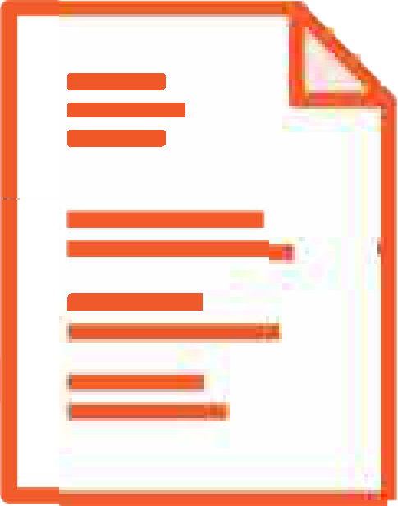







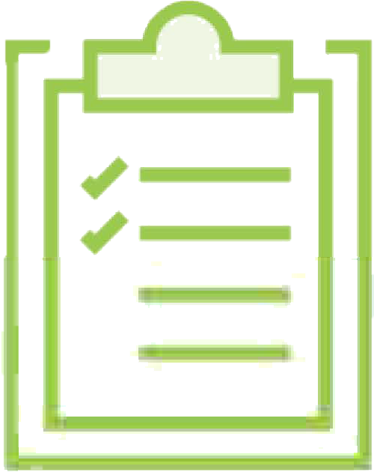
Business
BA
Developers
QA
Delivery Excellence
Notes:
Fast-forward 20 years, and it turns out the same thing happens when we build software. We're still playing the telephone game, only now instead of whispering sentences, we're using written specifications.
It all starts when someone from the business tells the BA, or business analyst, what feature she needs. In some projects this might be a simple conversation, but in many large organizations we have functional analysts or architects who come up with the requirements on behalf of the business, or for teams doing some form of Scrum, it might be a product owner who writes up the new requirement in the form of a user story.
Next, the BA writes up this requirement in a more detailed form, maybe a more detailed user story, or a Word document, or it might go into an agile project management tool, like Jira.
The development team picks up the story and uses it to start developing their code, and once the code is written, the testers pick up the feature to test. In many teams, these testers will have their own test plans that they derive from the requirements document.
And once the feature is tested of course, it can be delivered.

Slide 8

Business
BA
Developers
QA
Notes:
Can you see the flaws in this approach? It's the telephone game all over again. At each stage, the information passes from one person to another and it can be misinterpreted, or transformed, or forgotten. The features that we get aren't what the customer asked for, and they aren't what the customer really needs either. And at the end of the day, our users are unhappy. It's this communication gap that BDD tries to solve.
Transition: So what is BDD?

Slide 9




What is Behavior Driven Development (BDD)?
Collaboration
And
Conversation
Concrete Examples
And Business Rules
A common language and
Shared understanding
Faster Feedback
Through early
And effective
automation
Delivery Excellence
9
Notes:
BDD is first and foremost a collaboration practice.
Uses conversations about concrete examples and business rules to uncover uncertainty, ambiguity, and customer needs. Concrete examples is a great way to build understanding of a requirement. People relate better to concrete examples than abstract ideas.
Examples naturally lead to counter-examples and questions, and this enables us to build our understanding of a problem and flush out things we do not know.
BDD uses common language so everyone can understand what we are trying to achieve.
And BDD uses early-focused effective automation strategy to give us fast feedback about the feature and what it does. BDD is not a form of test automation or even a form of testing, but we can use test automation to write executable specification to get faster feedback.

Slide 10





BDD Starts With Conversation
Delivery Excellence
10
Notes:
Instead of passing requirements from one person to another and hoping everyone understands what is going on, the team that practices BDD get together early enough to have conversation about what customers really needs. It gives us techniques to structure to facilitate that conversation.
The team talk through concrete and examples and counter examples of how a user would interact with the application and what outcomes they would to achieve.
By the end of conversation everyone has a clear picture of what they need to build and just as importantly why it would be useful, and it’s not a one-way street. The team members get to ask questions and voice doubts, even to propose new ideas or suggestion that all go towards making features better. It’s a little bit like a building a picture of the feature bit by bit. This is called discover or illustrate phase.

Slide 11
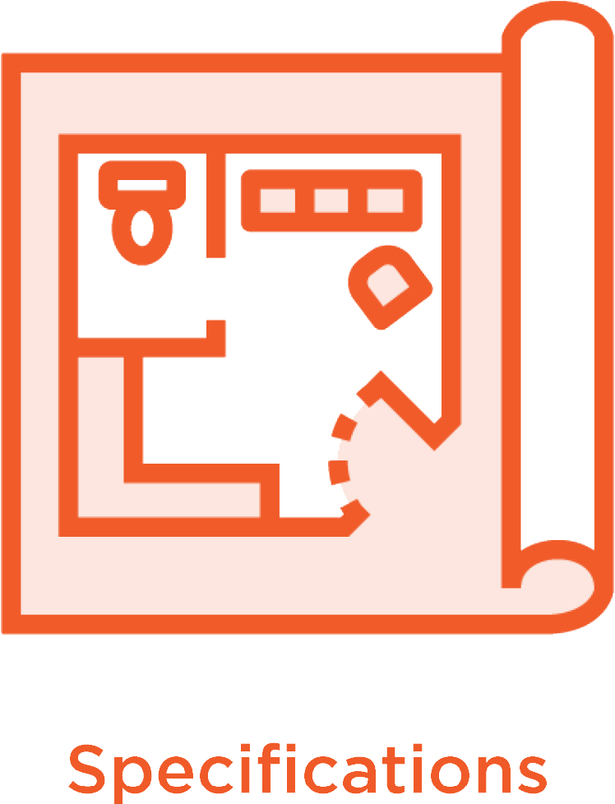
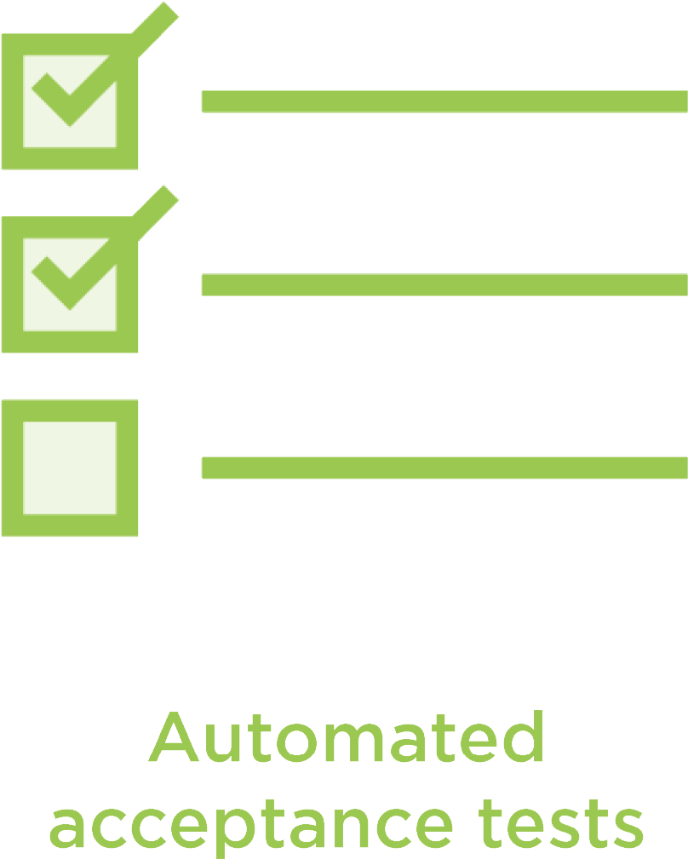
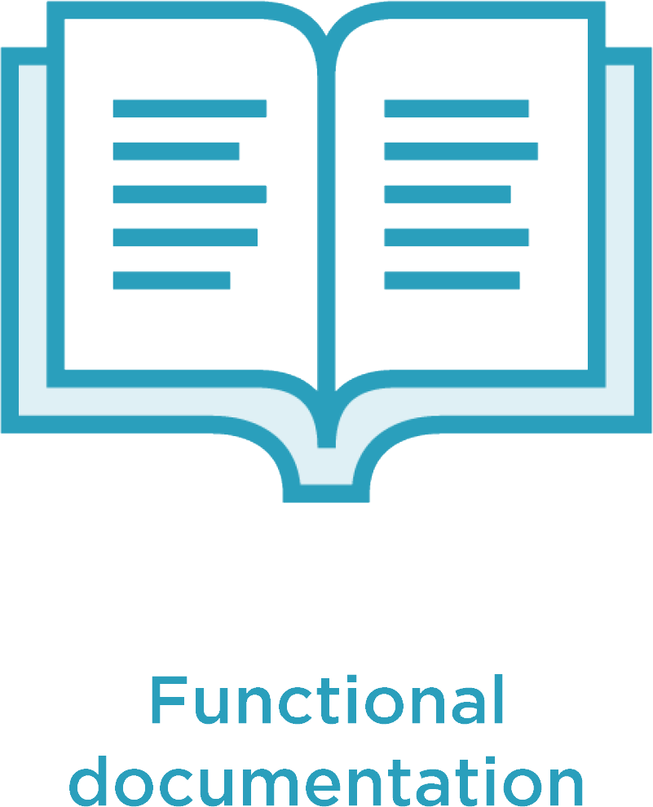
Single Source Of Truth
Notes:
So BDD works by giving teams a single source of truth. Executable specifications written in a business language that
work both as specifications and as automated tests,
and unlike traditional test automation, teams that practice BDD write these automated tests before, or as, a feature is being developed, so it helps drive and accelerate development work and helps the developers as well rather than just finding defects after the work is completed.
And finally, when a feature is delivered,
3. these specifications act as documented examples of how the application actually works, and the best thing about this kind of functional documentation is that as long as the tests pass, you can be pretty confident that it's up to date. Working collaboratively like this gives us massive benefits on many, many levels. Agile is all about collaboration, but BDD forces you to be really agile, not just to go through the motions.

Slide 12




Notes:
We often say that BDD helps us bridge the communication gap between business folk and the development team, but it also makes team members within the team itself communicate better. This early collaboration gives teams a deep shared understanding of what the business really needs, and this helps them deliver more innovative higher-value features, and teams that participate in this sort of activity really feel like they own the solution. It makes them more motivated and engaged.

Slide 13





Notes:
The automated acceptance tests give faster feedback and more confidence about the features we build. Teams practicing BDD generally see a huge drop in defects, not only from the automated tests, but more importantly because you don't get this communication gap and the developers really, really understand what they're building.

Slide 14
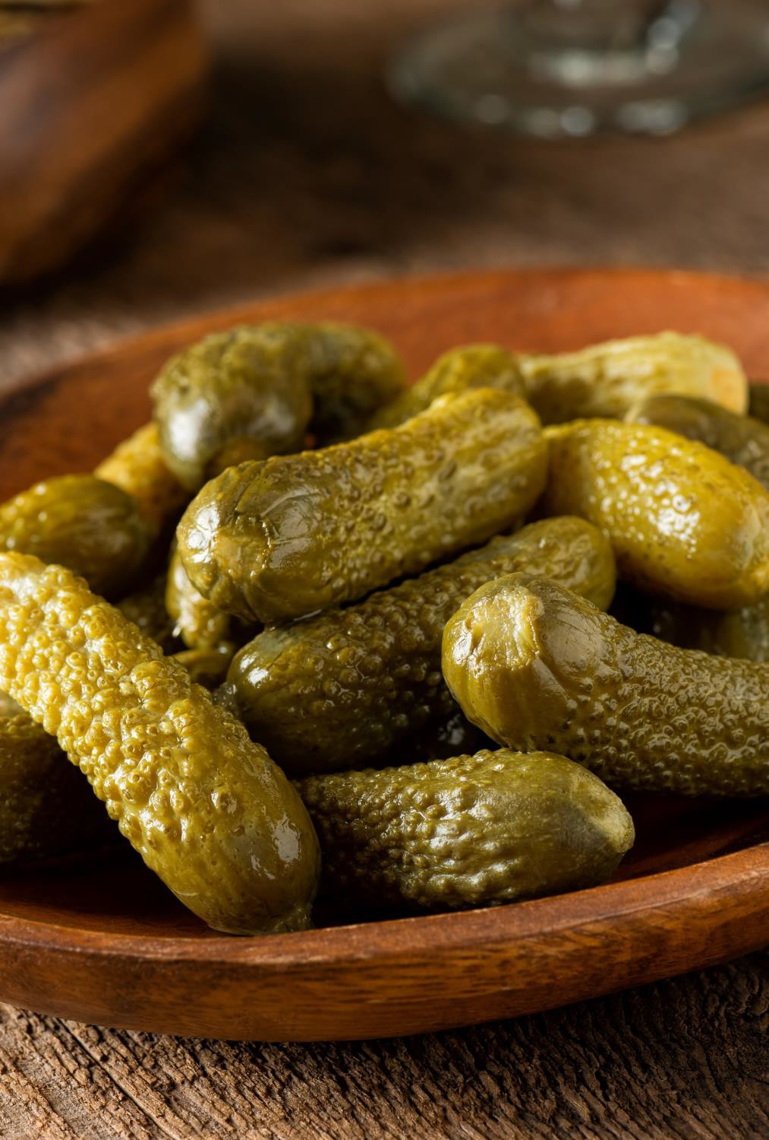





-
-
Notes:
What Is Gherkin?
So what is Gherkin and what is Cucumber, and where do they fit in to the BDD landscape? Well, Gherkin is that Given-When-Then notation we mentioned earlier. It's what we write our executable specifications in when we practice BDD with Cucumber. It's designed to be both business friendly and easy to automate. Doing both is a bit of a trick, and we'll look at some techniques later on to get this balance right. And Cucumber is the automation library that we use to run our executable specifications. Cucumber lets

Slide 15




Feature: Viewing upcoming orders
In order to plan my morning routine As a Morning Freshness customer
I want to the status of my upcoming orders
Scenario: Michael views his current orders Given Michael is a Morning Freshness member And he has ordered a "Green Goodness Smoothie When he views his upcoming orders
Then he should see the following orders:
| Order | Status |
| Green Goodness Smoothie | Ordered |
"
Notes:
Let's take a look at some real Gherkin. This is a simple Gherkin script. As you can see, it's written in almost plain English. You can also see that it's written in terms that a business person could understand, talking about business domain concepts like customers and orders that business people can relate to. Always remember, Gherkin is above all a communication tool. Finally, as we'll see shortly, this text is actually executable. We can wire this up to test automation code and turn these plain English requirements into a fully-fledged automated acceptance test. Now I did say almost plain English, and there is a little bit of structure that Gherkin scenarios need to follow

Slide 16





Feature: Viewing upcoming orders
In order to plan my morning routine As a Morning Freshness customer
I want to the status of my upcoming orders
Scenario: Michael views his current orders Given Michael is a Morning Freshness member And he has ordered a "Green Goodness Smoothie" When he views his upcoming orders
Then he should see the following orders:
| Order | Status |
| Green Goodness Smoothie | Ordered |
Notes:
You can see it here. Gherkin specifications describe features, so we start with a description of the feature we are discussing.
This one is from our demo project, which is an online delivery service for smoothies.
Customers could sign up and get their morning smoothie everyday for breakfast, and this particular requirement describes what happens when customers want to view their orders. A feature is illustrated by a number of examples, which we call scenarios. Each scenario illustrates a business rule, and sometimes you can have several scenarios to describe different variations or educators. The scenario here would be the first of many, and describes a customer, Michael, who wants to view his current order. Scenarios use special words like Given, When, and Then. At the start of each line, these can structure to our scenarios. The first two lines here are our preconditions. Given Michael is a Morning Freshness member and he has ordered a Green Goodness Smoothie. This describes a state of the system at the start of the scenario. The When is the heart of the scenario. It's where all the action happens. It's what the scenario is really about. In this case, we're saying when Michael views his upcoming orders. Finally the Then describes the outcomes we expect. Michael should see the orders that he's made with the correct status

Slide 17
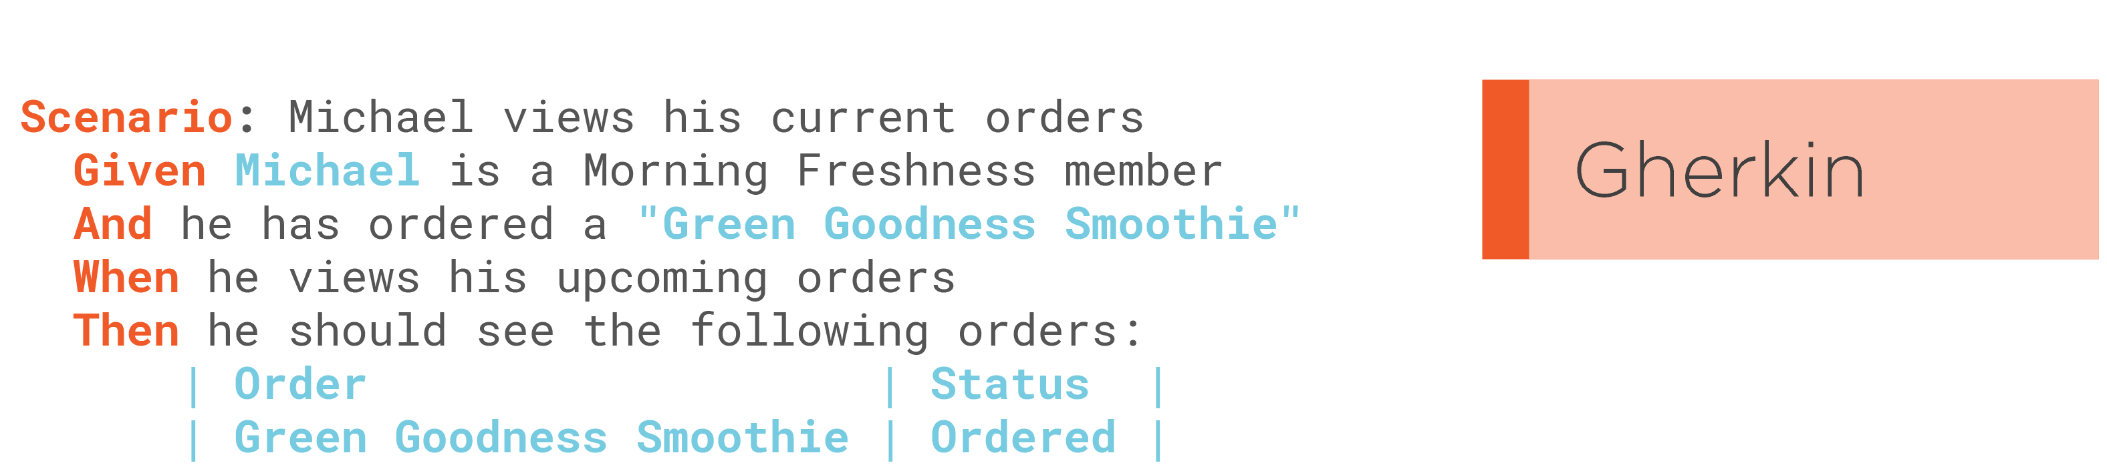
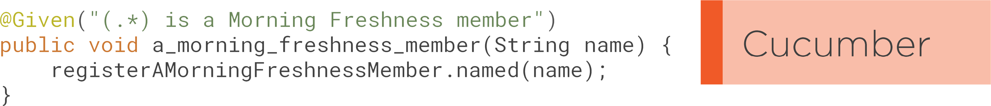
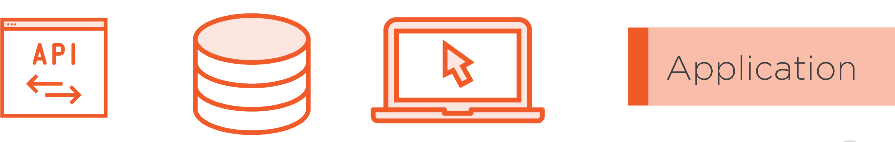
To tie it all together
Delivery Excellence
17
Notes:
. And what is Cucumber? Well Cucumber is a tool that lets us turn Gherkin scenarios like this into automated tests. So Gherkin is the notation we use to write our executable specifications, and Cucumber is the software we use to automate these executable specifications. And the software interacts with the application that we are testing.

Slide 18





Notes:
In this module, we'll be looking at what comes before Cucumber and Gherkin. We'll be looking at how teams collaborate to define the specifications that we end up writing in Gherkin and automating in Cucumber. In the previous module, we saw how there's a lot more to behavior-driven development than just writing Cucumber test scripts. The important part of BDD happens well before you open your development environment.

Slide 19
Illustrate
Delivery Excellence
19
Notes:
This is just a first phase of BDD called illustrate or discover phase. Product owner and the team get together a draw a picture or a mental model of the feature that business needs. Team talks about concrete examples about how features would work and their benefits. The main tools we use are whiteboards and post-its and aim to produce a list we can use for this features.

Slide 20
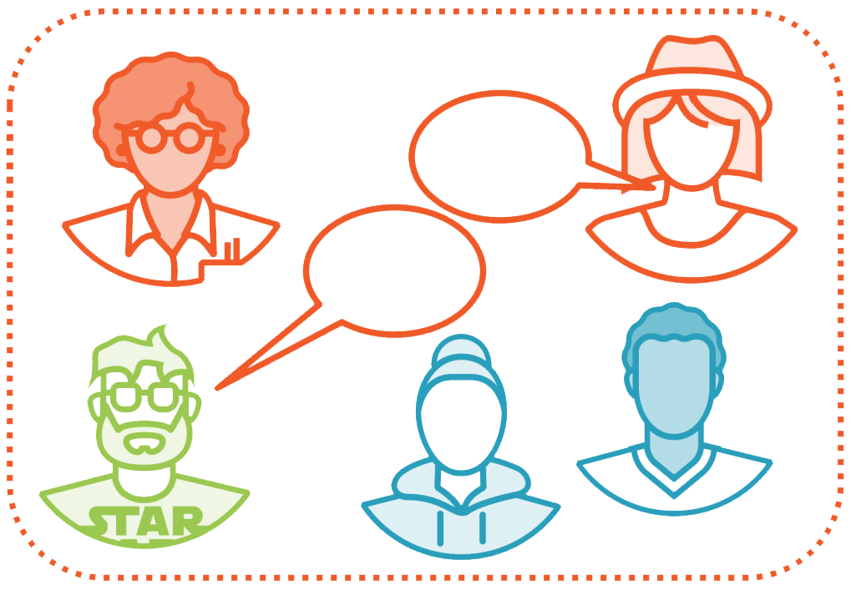
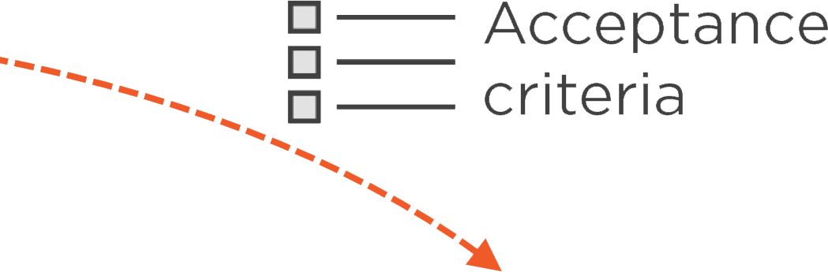
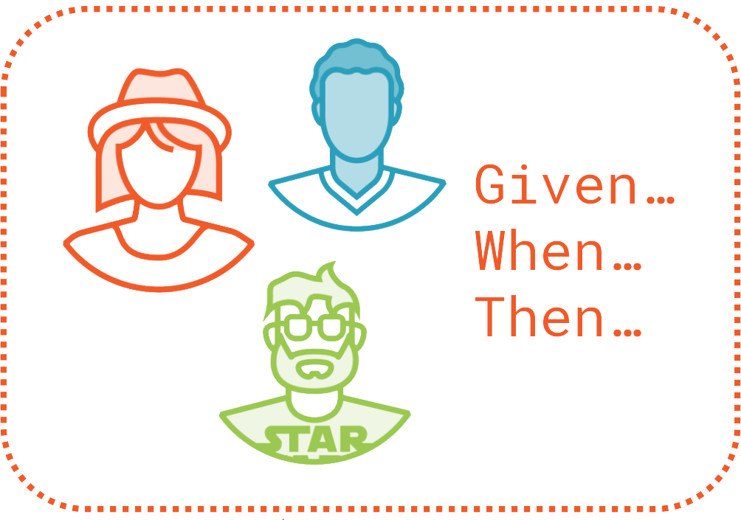
Illustrate
Formulate
Notes:
The rules and examples go into the Formulate phase. This is when the team members, often BA and Qas, turn these rules and examples into a format that can act both as specifications that a business person can read, as automated acceptance tests that we can execute as part of our test suite, and that is where tools like Cucumber or Specflow come into play.

Slide 21
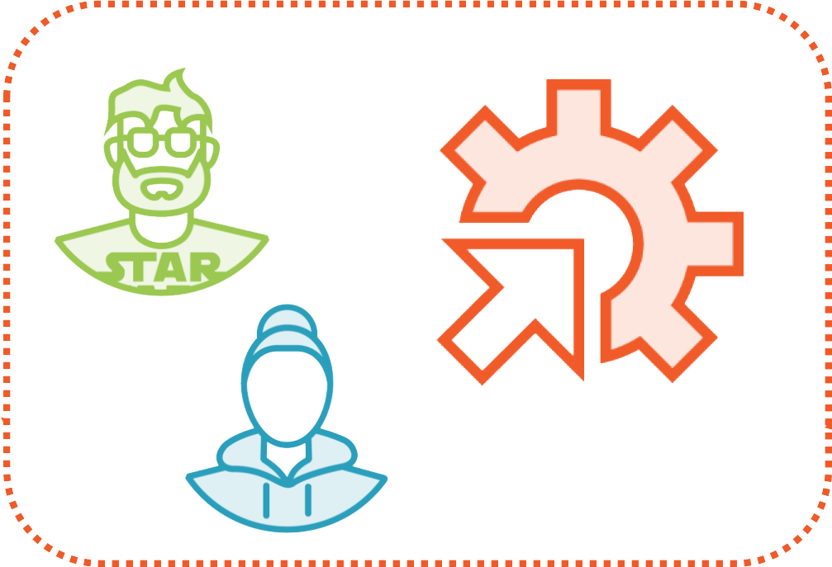
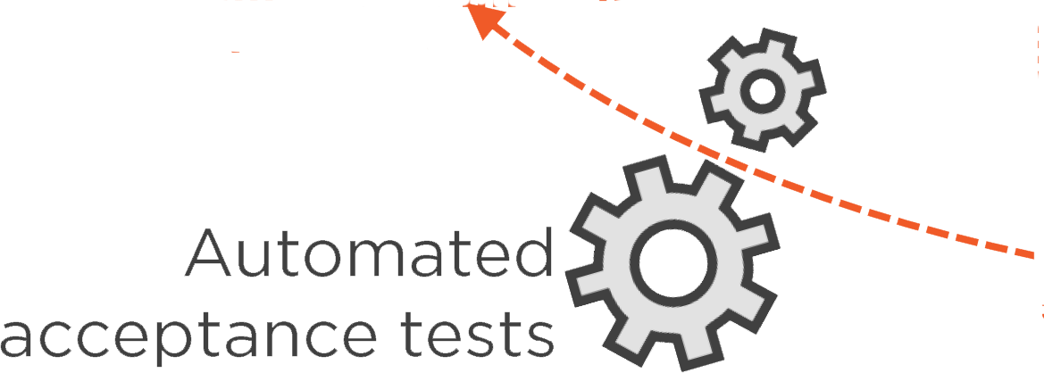
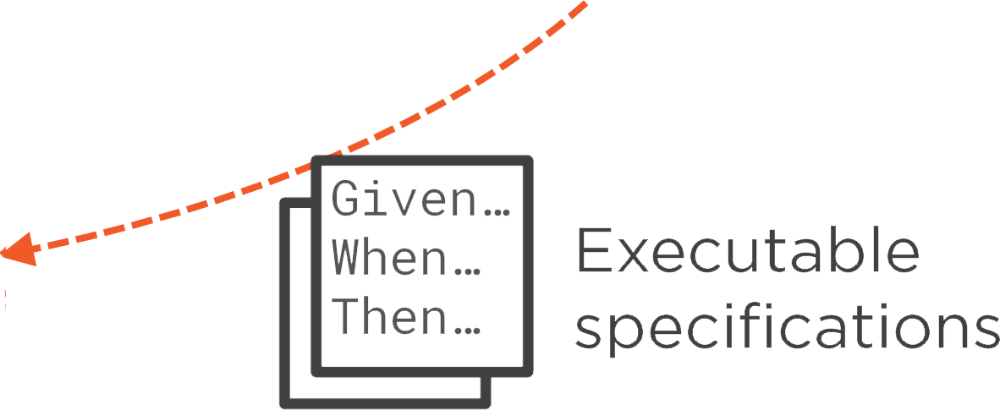
Illustrate
Formulate
Automate
Notes:
We write these executable specifications in a special language called Gherkin. It uses Given When Then notations that you already seen.
Next we write test automate code to turn these Given-When-Then statements, or these executable specification into automated acceptance tests. This happens before development starts or during the same sprint.

Slide 22
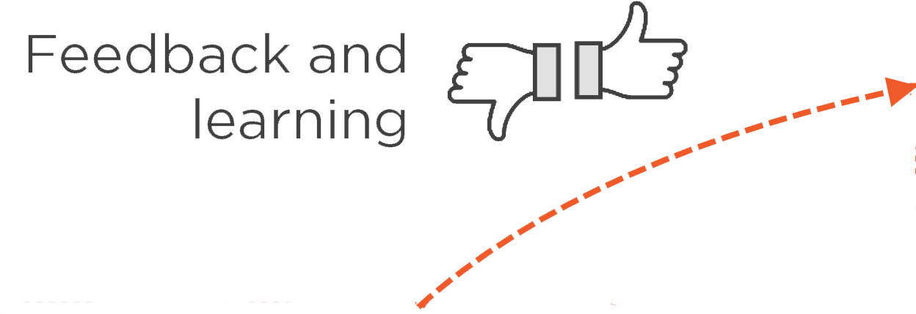
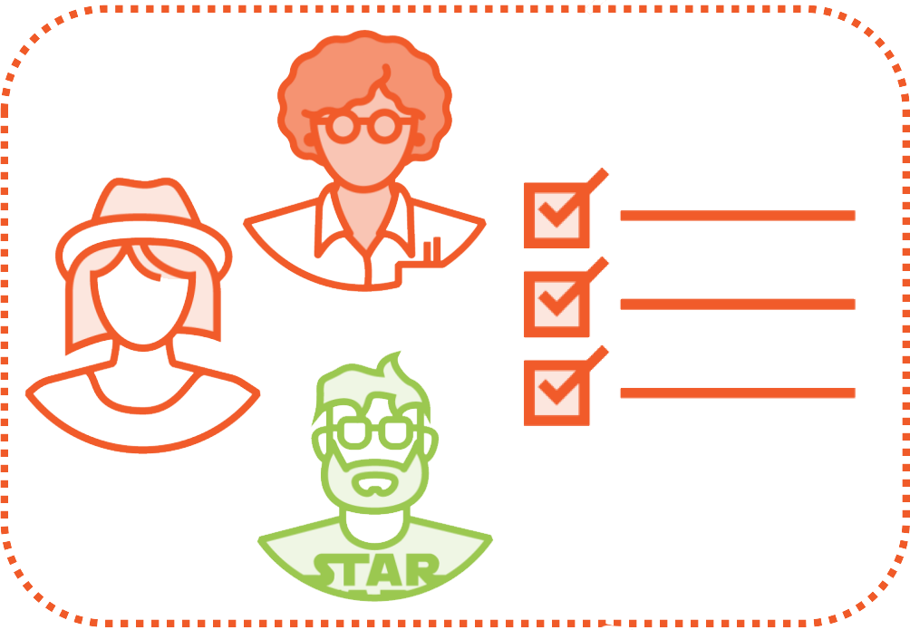
Illustrate
Validate
Formulate
Automate
Notes:
Once these tests pass, we can show business concrete evidence that the feature does what it does and what it is expected to do.
Since these tests are written in the same language as specifications, the business folk can read and understand them. Talking in domain specific language can increase confidence in software we deliver.

Slide 23
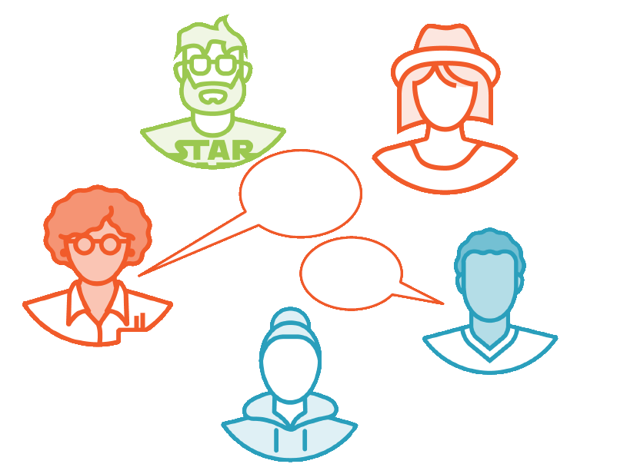
Discovering The Requirements
Building a shared understanding
Notes:
The important part of BDD happens when team gets together to have conversations about a feature or a user story, and when they come up with example rules that eventually become feature files.

Slide 24

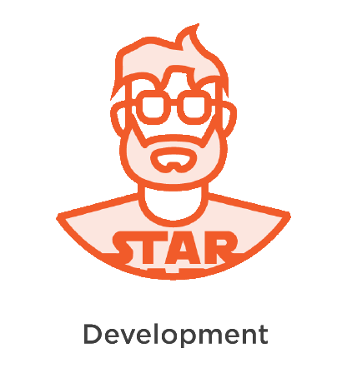

The Three Amigos
Security
PO
Infrastructure
Notes:
We often call the people who get together to discuss business rules as three amigos.
They represent business, technical solution, and we want someone with QA perspective to make sure requirements are precise enough to be tested.
The roles may vary and there can be more than three people presents. The point is the conversation is a dynamic exchange and not just a stamping of a user story. The aim of the conversation is to challenge the requirements to really understand the problem we're trying to solve, to spot any uncertainty or ambiguity, and make sure team understand requirements well enough for implementation.

Slide 25



Notes:
For teams doing Scrum, it typically happens before a sprint starts, leading up to sprint planning.

Slide 26
Discovering the requirements, BDD Style
Notes:
The team talks with the business to decide what would be the most valuable thing to build next.

Slide 27
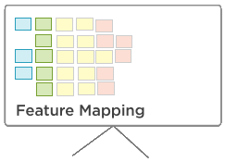
Discovering the requirements, BDD Style
Notes:
The team might use discovery techniques, such as Example Mapping, or Feature Mapping, or they might simply write up some examples on a whiteboard until the business and team are satisfied that they've understood the problem they need to solve.

Slide 28
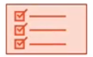
Discovering the requirements, BDD Style
Notes:
The story can then be slated into the next sprint and some of the team members, often a business analyst and a tester, will go away and turn these examples into feature files in a Gherkin scenario.

Slide 29
Discovering the requirements, BDD Style
Notes:
Transition: Let's take a look at how a typical BDD discovery session could play out.

Slide 30


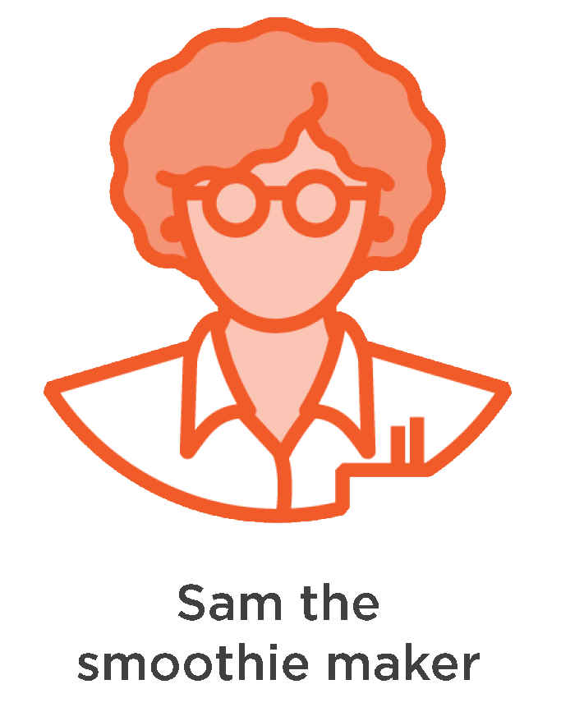

The Morning Freshness Team
Notes:
This is Sam. Sam is the founder of Morning Freshness, a startup that delivers smoothies and other beverages each morning to people who are too busy to make them for themselves. Sam is working with her development team to add features that will help her sell more smoothies. There's Belinda, the business analyst, Dave, the developer, and Tess, the tester.

Slide 31



























Sam has a problem to solve
Notes:
Sam has a problem. She wants her existing customers to buy more smoothies so that she can grow her business. The question is, how?

Slide 32

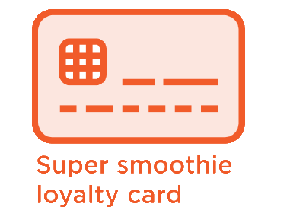


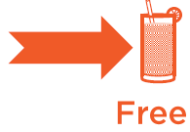

Sam has a problem to solve
Notes:
Fortunately, Sam has an idea. The super smoothie loyalty card. The idea is simple. When a customer with a loyalty card buys a certain number of smoothies, they get one free.
Let's see what a discovery session about this requirement might look like.

Slide 33
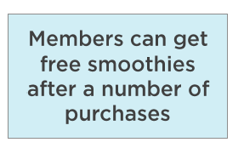
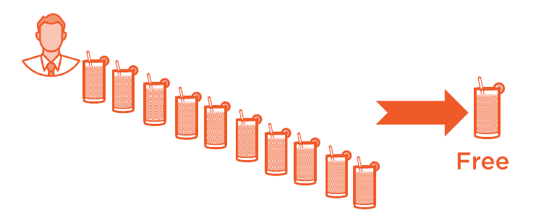

Can you give me an example?
Notes:
DT - So, how do you see these loyalty cards working? Can you walk us through an example?
PO - Sure. Basically, members get a free smoothie after they make a certain number of purchases. So imagine Michael is a regular customer. Over the past few months, he has bought 10 smoothies and this gets him a 11th one for free.

Slide 34
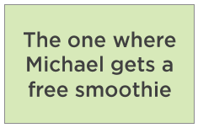
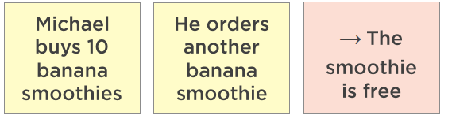
Can you give me an example?
Notes:
Let's call this example, the one where Michael gets a free smoothie.
QA - So let me get this right. Say Michael buys 10 banana smoothies, next time he orders a 10th banana smoothie, he gets it for free.
PO - Assuming he has signed up for the loyalty program, then yes, that's right.

Slide 35
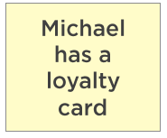
Can you give me an example?
Notes:
QA - Okay, so first he needs to have a loyalty card. Gotcha. Does it make a difference what kind of drink Michael has bought?

Slide 36
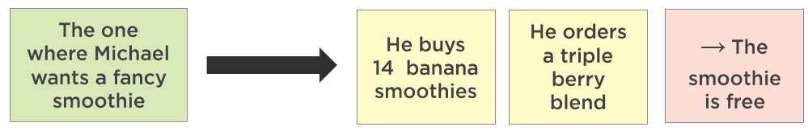
Can you give me an example?
Notes:
PO - Yes. Not all smoothies have the same price. So if you want to buy, say, a triple berry blend smoothie, which is one of our special fancy smoothie range, you would need to have bought more banana smoothies.
BA - How many more?
PO - Fourteen. It's based on a point system.

Slide 37
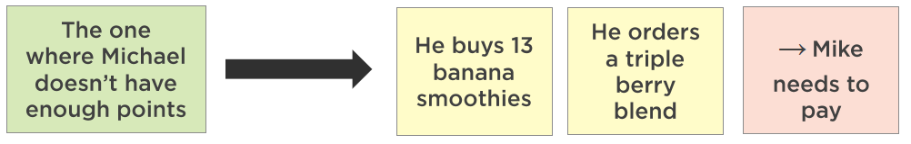
Can you give me an example?
Notes:
DT - Okay, so if I understand correctly, it works like this: Suppose Mike wants a fancy smoothie. If Mike has bought 14 banana smoothies, he can get a triple berry blend for free, but if he had only bought 13 he would have to pay for it.
PO - That's right.

Slide 38
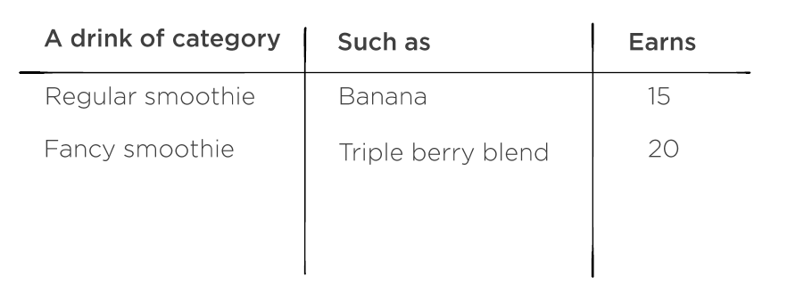
Can you give me an example?
Notes:
DT - Could you walk us through how the point system works in more detail? How many points do I get when I buy a smoothie, and how many points do I need to get a free drink?
PO - Sure. So you earn points whenever you order a smoothie, and when you earn enough points, you can get a free one, but not all smoothies cost the same number of points. You need to earn 150 points to get a free regular smoothie, like banana smoothies, but for a fancy smoothie, like our famous triple berry blend, you would need 200 points.
DT - And are all smoothies worth the same number of points?
PO - No. Fancy smoothies earn you 20 points, whereas regular smoothies only earn you 15. We could say that a drink of category regular smoothie, such as a banana smoothie, earns 15 points, and a fancy smoothie, like the triple berry blend, earns 20.

Slide 39
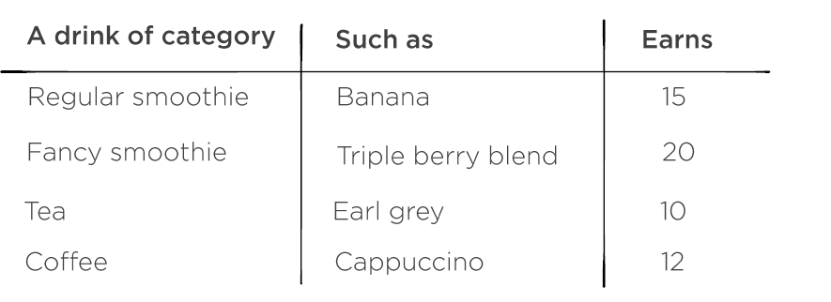
Can you give me an example?
Notes:
DT - Are there any other types of smoothie that would earn different points?
PO - No. We only have two categories of smoothie, regular and fancy, but we might want others later.
DT - Are there any other types of drinks that can earn points?
PO - Yes. A tea, like Earl Grey or English Breakfast, will earn 10 points. Any coffee, like an espresso or cappuccino, earns 12.

Slide 40
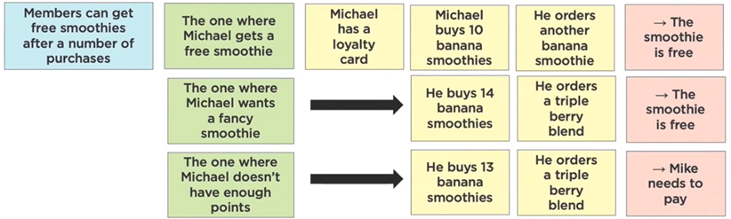
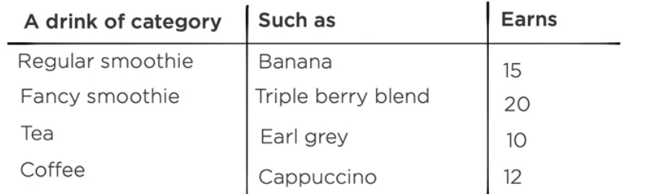
“Can you give me an example?”
Notes:
Teams that practice bdd use examples and tables that come out of these conversations to from acceptance criteria for the stories that they need implemented.

Slide 41
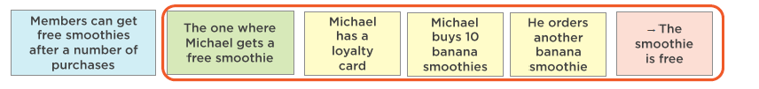
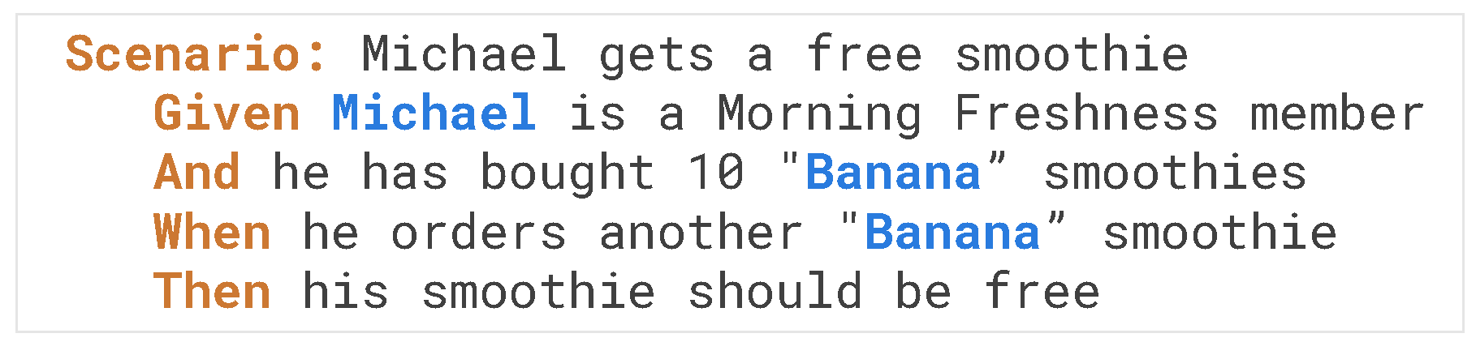
“Can you give me an example?”
Notes:
These acceptance criteria are then used to write scenarios in Given When Then format. The quality of these scenarios depend on how well we make these conversation work.
In the next section we going to see how teams structure these conversations to make them more focused and productive.

Slide 42

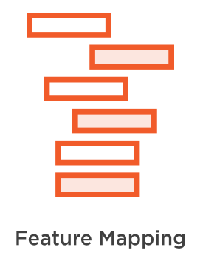
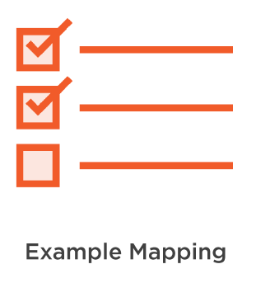
Example Mapping and Feature Mapping
Notes:
Sometimes a simple conversation is enough, but sometimes we need to guide our conversations.
There are three practices:
Writing down list of examples on a white board or butcher paper.
Example mapping - practice to use color post its for examples and counter examples. Which can help us think of edge cases.
Feature mapping - useful when we want to brake down example in more detail and try to understand what are inputs and output for each example.

Slide 43
















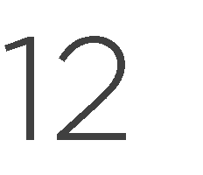






Notes:
Tables are great way to model many requirements. Particularly when there are clear inputs and outputs.
On one side we have business rules, followed by some sample input, and then output. Tables can be more complex than that.
For example, the may have more than one input column.
It’s important that table contains only the information that is needed for the business rule being illustrated and nothing that would distract a reader. For example, we may be tempted to add price to that table, but this would not be relevant to the business rule.
As we will see later, tables are easy to express in gherkin.

Slide 44





Notes:
In Example Mapping, we have conversations about business rules, and we illustrate these rules with concrete examples and counterexamples. Sometimes when we discuss an example, or a counterexample, it leads us to discover new rules, or maybe it helps us unearth a question that we didn't know the answer to, and later on we can use these examples as the basis to write our Gherkin scenarios. Let's look at a simple Example Mapping action.

Slide 45

















Notes:
We'll start with a new user story about a buy one, get one free special. Suppose that one of our acceptance criteria is that the free drink needs to be in the same category, or a lower category, than the one we buy. Each drink has a category, so fancy smoothies are in a higher category than regular smoothies, and so on. One example might be the one where our user, Mike, orders two banana smoothies, so one of them is free.
A counterexample might be the one where Mike orders a banana smoothie and a triple blend berry smoothie. So in this case, he'll be charged the price of the triple berry blend.
But this leads to another question, what if he orders a croissant as well? And so when we talk about this, we might discover that we have a new rule that the special only works with drinks. And as an example for this rule, we could have something like the one where Mike orders a banana smoothie and a croissant.

Slide 46







→
→
→
Notes:
The last technique is Feature Mapping, which you've already seen in action in the previous clip. Feature Mapping is like Example Mapping, but rather than just listing down rules and examples, we break each example down into steps and outcomes, or as we like to call them in Feature Mapping terms, consequences.
For each step, we look for variations that might lead to different outcomes or other business rules that we hadn't know about, and for each outcome, we ask ourselves what else should happen? What other outcomes should we consider? Here is a feature map we saw in the previous clip.
Now that we've seen how feature maps work, this might make a little bit more sense. On the left was have a business rule. Members can get a free smoothie after a certain number of purchases. Then we list some examples, green cards, like in Example Mapping, the one where Mike gets a free smoothie, the one where Mike wants a fancy smoothie, and so on. And for each of these examples, we break them down into steps, which are the yellow cards.

Slide 47


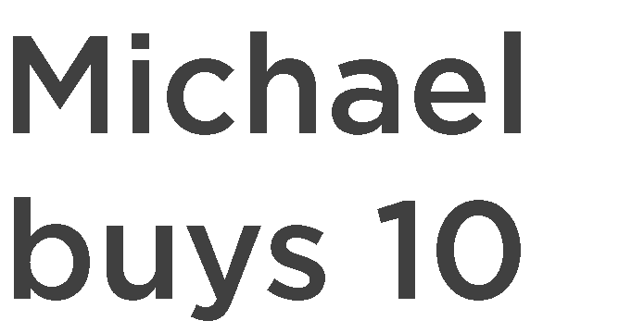
































→
→
→
Notes:
So for the first one, we have three steps. Mike has a loyalty card, Mike has already bought 10 smoothies, and when he orders anther smoothie, and then we have a consequence in pink. The consequence here is the smoothie is free. Feature Mapping is a great technique for more complex requirements, for user stories that involve a user journey or a workflow, or simply when there are a number of inputs that needs to be considered. Features maps are also a great way for teams to explore a brand-new requirement or a domain that they're unfamiliar with.

Slide 48



-
-
-
Notes:
So what have we learned in this section? Well, we've seen that BDD always starts with a conversation between the business and the development team, and the conversation uses techniques like Example Mapping, or Feature Mapping, or just writing out tables or listing examples to go through concrete examples and business rules and to get a deeper understanding of the business requirement. We've also seen how these examples form the basis for our acceptance criteria that we'll later on turn into Cucumber/Gherkin Given-Then-When scenarios.

Slide 49
Reduce:
Cycle Time
Rework
Rejection
Production Issues
Implementation Costs
Convincing Power
Product Owner Responsibilities:
BDD Environment | Agile without BDD
Requirement Workshops | Writing User Stories
Example Mappings | Presenting stories to the team
Scenario Reviews | Answering ad-hoc questions during implementation
Implementation Feedback | Collecting deviations in the expected result in the sprint review
 | Managing and prioritizing requirement-related bugs
Notes:
In order to get your users engaged in the process, we have to demonstrate that BDD works in your context.
Our aim is to give team enough enthusiasm to give it a try.
Reduced cycle time, rework, rejection, number of production issues, implementation costs under control.
Nothing is more convincing then an examples.
Team needs to find a way to sell the BDD approach. This can be challenging because of the TLD, have formal or legal distance of the team. Or see BDD as testing or development technique. Developer only BDD or tester only BDD and should be considered bad practice. Collaborating on dev team member provides some benefits, but without business scenarios become too technical. Consider your situation as a temporary solution towards full collaboration. Think about your scenarios as business examples. Use realistic data and business readable data. Try to focus detail discussion requirement by examples. BDD is for solving problems. In order for business to collaborate, point out pain points in your process.
Issues:
Product Ownder is overloaded – BDD can help reduce PO’s workload by focusing on communication.
BDD Product Owner activites:
Participate in requirement workshops,
Example mappings,
Review the scenarios,
Give feedback about implemented application
Compare this with:
Writing specifications
Presenting stories to the team
Discussing ad hoc questions during implementation
Collecting deviations in the expected result in the sptin review
Managing and prioritizing requirement-related bugs.
Although bdd needs time, we avoid re-discussing the same topics over and over again.

Slide 50
Bad practice, but a step in a right direction.
Developer Only BDD
Should only be used as a case to prove the benefits of BDD in the context of your business
STOP if business is not on board, but continue on asking for examples that support acceptance criteria because that is the only way to make sure what you are developing is correct.
Notes:
In order to get your users engaged in the process, we have to demonstrate that BDD works in your context.
Our aim is to give team enough enthusiasm to give it a try.
Reduced cycle time, rework, rejection, number of production issues, implementation costs under control.
Nothing is more convincing then an examples.
Team needs to find a way to sell the BDD approach. This can be challenging because of the TLD, have formal or legal distance of the team. Or see BDD as testing or development technique. Developer only BDD or tester only BDD and should be considered bad practice. Collaborating on dev team member provides some benefits, but without business scenarios become too technical. Consider your situation as a temporary solution towards full collaboration. Think about your scenarios as business examples. Use realistic data and business readable data. Try to focus detail discussion requirement by examples. BDD is for solving problems. In order for business to collaborate, point out pain points in your process.
Issues:
Product Ownder is overloaded – BDD can help reduce PO’s workload by focusing on communication.
BDD Product Owner activites:
Participate in requirement workshops,
Example mappings,
Review the scenarios,
Give feedback about implemented application
Compare this with:
Writing specifications
Presenting stories to the team
Discussing ad hoc questions during implementation
Collecting deviations in the expected result in the sptin review
Managing and prioritizing requirement-related bugs.
Although bdd needs time, we avoid re-discussing the same topics over and over again.

Slide 51
Environment Pre-requisites
JDK8 or higher
Build Tool like Maven
You need an IDE IntelliJ or Eclipse
Setting up your
computer
Delivery Excellence
51
Notes:
In order for cucumber to work with Java, we need Java 8 or higher.
We also going to need a build tool like Maven or Gradle. Build tools help you manage dependencies and execute your test scripts.
Maven has a ton of functionality.
It would also make it easier if you installed a plugin for an IDE you going to use. If you are using IntelliJ, it’s a Cucumber plugin and if your are using Eclipse, it’s a plugin called ‘Natural’.

Slide 52
Environment Pre-requisites
JDK8 or higher
Go to command line and type at the prompt:
>Java -version
Build Tool like Maven
Go to command line and type following at the prompt:
>mvn -version
You need an IDE IntelliJ or Eclipse
Let’s check
Our Environment
Delivery Excellence
52
Notes:
Let’s check to see if you have all the necessary tools installed for us to write our BDD Scenarios.

Slide 53
Overview of Environment Setup
IDE
IDE Plugins
Dependencies
Project Structure
Runner Class
Delivery Excellence
53
Notes:
In order to be able to execute automated cucumber acceptance tests, following tools have to be configured on your machine:
You going to need an IDE Plugin, dependencies added to your project, create a project structure, and writing a runner class.

Slide 54
Set up IDE for Cucumber
Open IntelliJ and go to Configure
Open Test Project
Delivery Excellence
54
Notes:
Let’s open our IntelliJ, go to Configure and then Plugins because first we want cucumber plugin installed.
We need to activate and restart intelliJ

Slide 55
Set up IDE for Cucumber
Download Sample Project
Configure IDE
Delivery Excellence
55
Notes:
Download sample project, open it in IDE, and let’s examine it.

Slide 56
Cucumber/Junit Version of HelloWorld.java
Project Structure
POM.xml file
Create a feature file
Feature name
Scenario
Given – When -Then
Add Test Runner
Structure
Overview
Delivery Excellence
56
Notes:
We are going to create our first HelloWorld Version of the application.
I will open the skeleton project and go over the project structure with you.
Since we are using Maven as a build tool, the project structure must follow this structure.
You’ll find a zipped version of the starter project.
Import maven project into Intellij.
We can see the structure and the pom file with dependencies.
Now let’s create first feature file:
Give the feature a name, create scenario, then given when then.
Before we can run this test, we need a test runner, which will be in our test > java folder
Let’s give it a name like CalculatorTest and inside our test we will turn it into a cucumber runner. We will run this test with cucumber runner class.
So let’s run it and see what happens.
When cucumber runs a test that has not been implemented, it will give us all the unimplemented class.
Copy the unimplemented step definitions and paste them into CalculatorStepDefinitions method.
Then we will create a calculator in a package called calculator.
Then we will create an add method for calculator class.
In Then step do an assertion.

Slide 57
Cucumber Java
Test Runner
Library
Dependencies
Assertion Library
Delivery Excellence
57
Notes:
Three main dependencies that you’ll need:
Cucumber itself, a Test Runner, and an assertion library

Slide 58
Cucumber Java
Junit
Assertion Library
Test Runner
Cucumber-java
Hamcrest or
AssertJ
Cucumber-junit
Delivery Excellence
58
Notes:
For Cucumber, we need core cucumber library and a class runner
We’ll be using Junit, one of the most widely used test runner in the java world.
We also need to describe outcomes we expect and describe what happens when something does not work, for that we need assertion libraries, and we will be using Hamcrest or AssertJ libraries to do that.

Slide 59
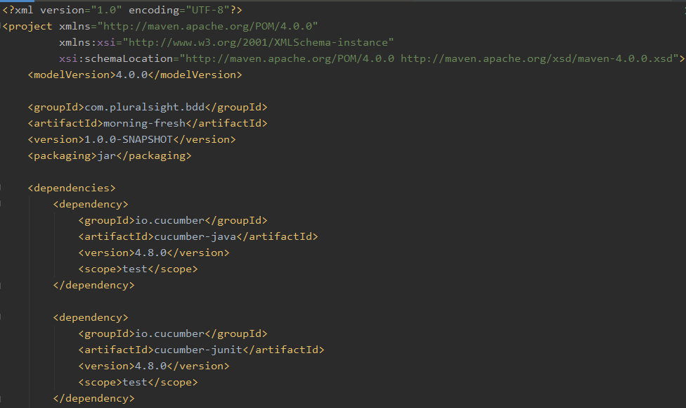
Cucumber Dependencies in Maven
Delivery Excellence
59
Notes:
In Maven we add these dependencies to pom.xml
With cucumber-java dependency we will follow step definitions with annotations approach.
Cucumber-Junit dependency in maven allows us to run our tests using maven build and also allows us to run these test cases as part of the build.

Slide 60
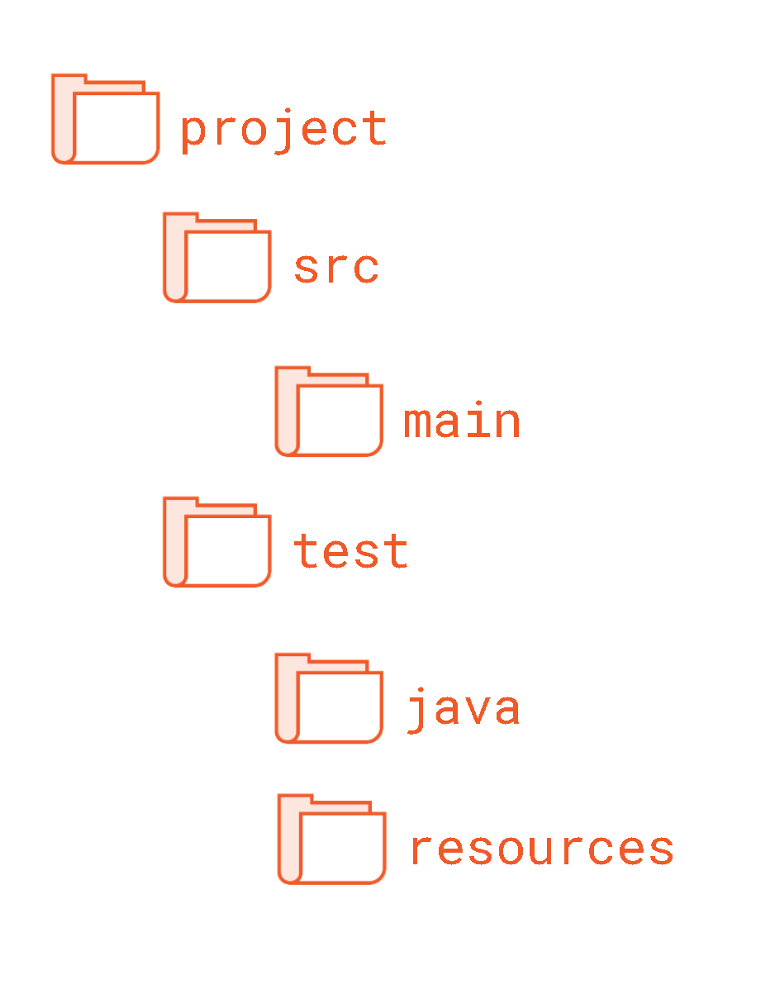
Project Structure
Pom.xml
Application Code
Step Definitions and Test Code
Feature Files
Delivery Excellence
60
Notes:
The project structure we are going to be using is fairly typical of Maven and Gradle Cucumber projects. At the project level, we have a pom.xml file.
Source code goes into Source directory and application code goes into main directory, and test code goes into source/test

Slide 61
Cucumber/Junit Version of HelloWorld.java
Project Structure
POM.xml file
Create a feature file
Feature name
Scenario
Given – When -Then
Add Test Runner
Structure
Overview
Delivery Excellence
61
Notes:
Create new project

Slide 62
Given-When-Then
Basic Gherkin Scenarios
Scenarios and Features
Feature Files and Directory Conventions
Cucumber
Deep Dive
Data Tables
Backgrounds
Scenario Outlines
Notes:
Simple gherkin scenarios
How gherkin scenario organized into feature files
How feature files organized in the project structure
We’ll learn how to use gherkin features to write more expressive scenarios, using features like data table, background scenarios, and scenario outlines

Slide 63


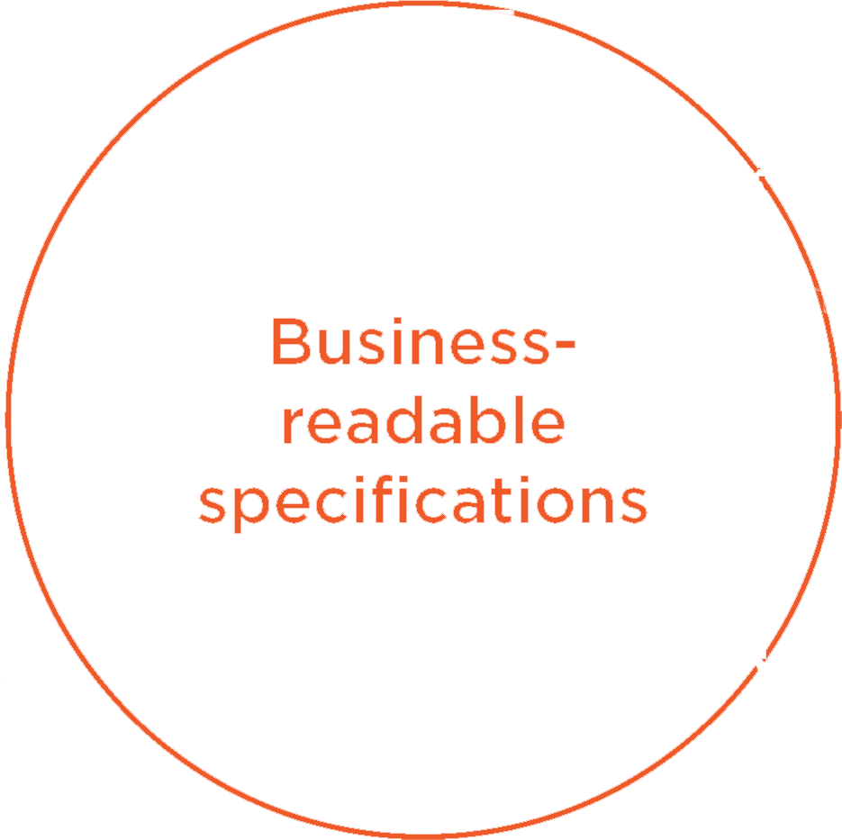
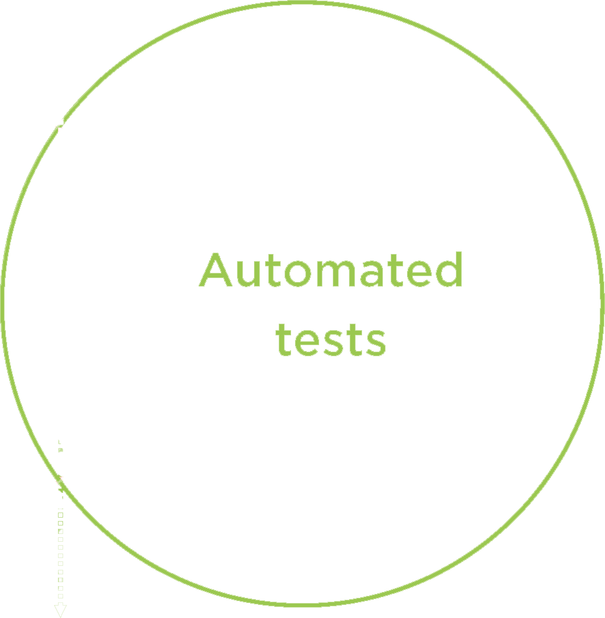



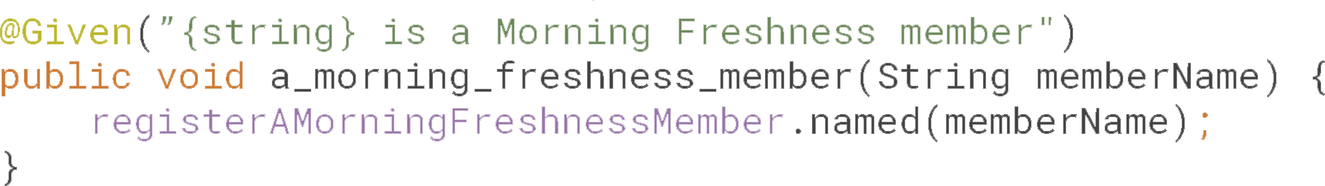
Gherkin
Delivery Excellence
Notes:
As we mentioned before, Gherkin sits right between realms of specification and of automation.
Given what then notation in gherkin sits right between our budiness readable specifications on one hand and automation test, our automated acceptance tests which can be executed to see if our application really works as specificied.
The development team writes code for each line of these specifications so that these plain english step drive automated tests.

Slide 64


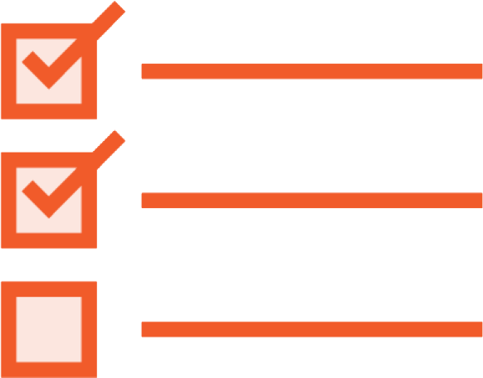

Anatomy of Gherkin
Initial State
Action under test
Expected Outcome
Delivery Excellence
Notes:
Gherkin scenario follows a simple pattern:
You start off by describing an initial state of the system where you prepare your test data
Next you perform an action your want to test
Finally you describe an outcome

Slide 65
Using “And” in Given section and Then section
Multiple Scenarios
Using “But” in Then section
Complex Gherkin
Scenarios
Notes:
Multiple Given statement

Slide 66
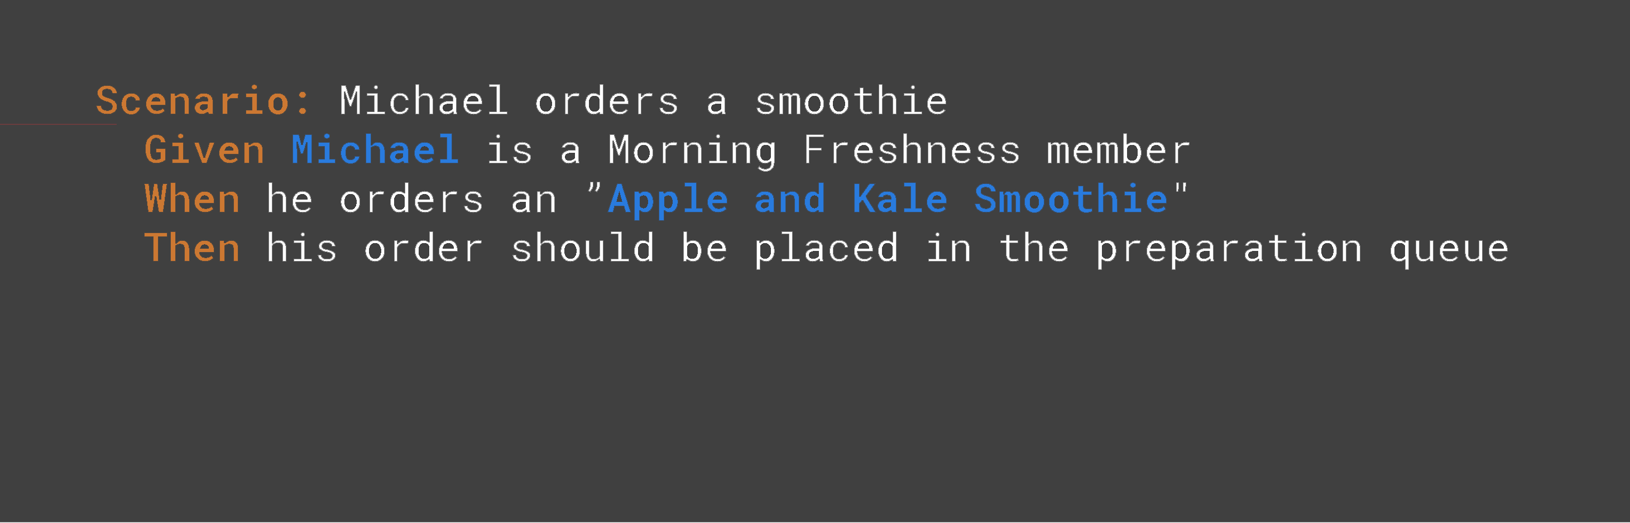

GIVEN describes the preconditions
WHEN describes the action under test
THEN describes the expected outcomes
Delivery Excellence
Notes:
Given describes a precondition
When describes an action under test
Then describes results, what we think should happen if the feature executes correctly
Right at the top we have name of the scenario, think of it as section title in your specificiation document. Gives overview of what the scenario is all about.
If you have more than one scenario in a feature file, you should be able to scan through the scenario titles and they should read as toc.
The scenario title usually describes the business context or situation or maybe what user wants to od. What business rules we discussing. What happens under certain situation.

Slide 67
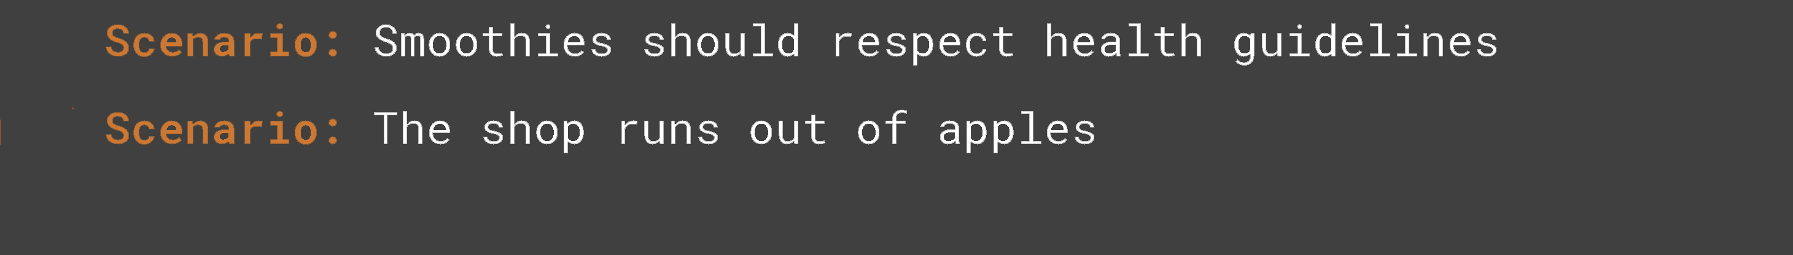
Scenario describes business context or situation
What does the user want to do?
What business rules are you illustrating?
Delivery Excellence
Notes:
Scenario title should read like an table of contents for feature files.
Scenario Title describes the business context or situation. What does the user want to do? What business rule are you illustrating? A scenario title can also summarize what business rule we discussing.
Feature files can have more than one scenario that describes features we are illustrating

Slide 68
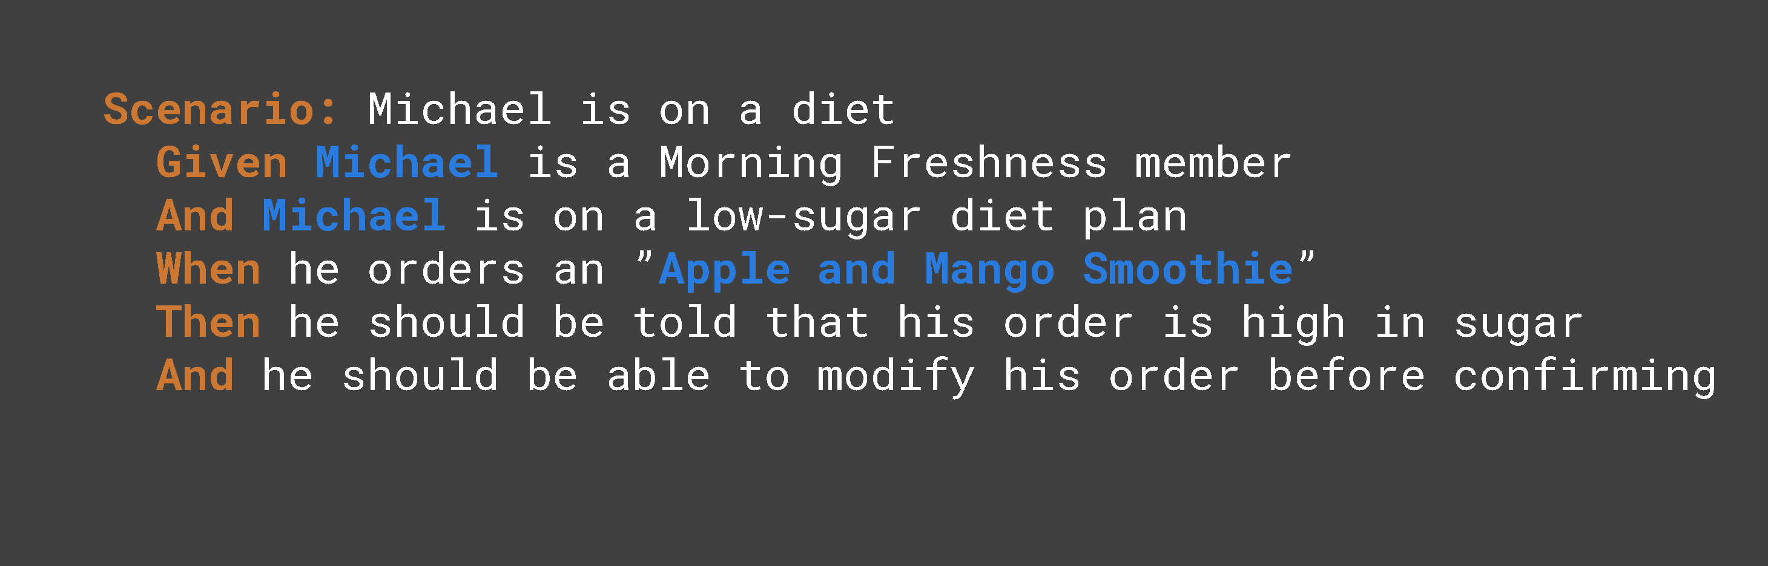
Delivery Excellence
Notes:
Sometimes more complex scenarios are requires.
The user option we describing might involve several steps.
Suppose Michael is on diet, we may need an extra ‘And’ in the Given section.
Then section should have an outcome for both pre-conditions.
Sometimes “but” fits more smoother than an “and”

Slide 69

Features and
Scenarios
Delivery Excellence
Notes:
Multiple Given statement

Slide 70


Delivery Excellence
Notes:
Scenarios do not exist in isolation. Scenarios are always parts of features. A feature is a piece of useful functionality that we can deliver to our users.
We describe these features using business rules and examples.

Slide 71

Delivery Excellence
Notes:
And when we want to build these features we can group the scenarios together to form to form user stories. We use these user stories to plan and deliver our work.
At the end of the sprint, these stores are no longer needed.
But features and it's scenarios become part of living documentation and that is always needed.

Slide 72

Delivery Excellence
Notes:
But features and it's scenarios become part of living documentation and that is always needed.

Slide 73

Folder Structure
Delivery Excellence
Notes:
We store these features in feature files which have .feature suffix. Convention is to keep them in the test > resources > features directory.

Slide 74

Folder Structure
Delivery Excellence
Notes:
We store these features in feature files which have .feature suffix. Convention is to keep them in the test > resources > features directory.

Slide 75
Folder Structure and Feature files
ordering_smoothies.feature
delivering_orders.feature
Scheduling_order.feature
Delivery Excellence
Notes:
For smaller programs feature files can be organized in a more flat structure, but for larger ones, we often place these feature files in subdirectories which represent higher level concerns such as EPICs or capabilities or modules.

Slide 76
Feature File Sections
Background Section
Features and
Scenarios
Embedded Tables
Scenario Outlines
Delivery Excellence

Slide 77


Delivery Excellence
Notes:
A feature file will always have a title and at least one scenario.

Slide 78


Delivery Excellence
Notes:
A feature can also have a description. Good place to put an executive summary of your feature. Give context to why these features are useful.

Slide 79
Background Section
Delivery Excellence
Notes:
We can use what we call a background section to make scenarios more concise.
Any step in the background section will be executed at the start of each scenario so they are a way to avoid duplication when you setting up your test context. It is important to remember that any step in the background section will be executed before each step in the feature file.

Slide 80


Background Section
Delivery Excellence

Slide 81

Data Tables – Embedded Tables
Delivery Excellence
Notes:
Suppose we have a feature where users gets daily news about topics they are interested in.
For example Michael is interested in a few topics. Adding them to the Given statement creates a repetition.

Slide 82

Data Tables – Given Section and Then Section
Delivery Excellence
Notes:
We can simplify all the conditions by creating an embedded table. We can use a table to represent a list of values that we pass into our scenario.
We can also use a table in THEN section to represent a list that the user should see.
Helps users focus on important pieces of the scenario.

Slide 83
Data Tables with headers
Delivery Excellence
Notes:
We can have a scenario that has a When Section with multiple conditions.

Slide 84

Data Tables – When Section and Then Section
Delivery Excellence
Notes:
Using data table, table with headers, we can use pipe delimited table, with a column name.
Product and Quantity in this case.
We have three rows of data corresponding to three items being ordered.
You can always add more data to the table just by adding a row.
If you want to add more data, you can add extra column. Let's say you wanted to add price.

Slide 85

Tables and Maps
Delivery Excellence
Notes:
Tables can be made in different ways, sometimes it makes sense to put headers in the top row. There are times when it makes sense to use map format. When you want to specify calorie count for each item.

Slide 86
Multi-Column Map
Delivery Excellence
Notes:
We can take tables a little bit further. Another map format is multi-column map. This is a map structure, but the key values are on the side. But each entry is another map where the keys are quantity, calories, and the total value. IT's more complicated, but intuitive read.

Slide 87
Scenario Outlines
Super Smoothie Loyalty Card Program
15
Delivery Excellence
Notes:
Let’s talk about scenario outline and how that format is used in the feature file.
In the requirements gathering section that the dev and business set in on last time, they came up with a few rules: each time you buy a drink, points are added to your card.
For basic smoothies you get 15 points, for fancier one you get 20 points, for tea you get 10 points, and for coffee we get 12 points.

Slide 88
Scenario Outlines
Super Smoothie Loyalty Card Program
35
Delivery Excellence
Notes:
Scenario Outlines use tables differently
Going back to our example, during requirements gathering session, let's say we came up with a few rules: each time you buy a drink, you get points added to your card.
For basic smoothies you get 15 points, for fancier one you get 20 points, for tea you get 10 points, and for cofee we get 12 points.

Slide 89
Scenario Outlines
Super Smoothie Loyalty Card Program
45
Delivery Excellence
Notes:
Scenario Outlines use tables differently
Going back to our example, during requirements gathering session, let's say we came up with a few rules: each time you buy a drink, you get points added to your card.
For basic smoothies you get 15 points, for fancier one you get 20 points, for tea you get 10 points, and for cofee we get 12 points.

Slide 90
Scenario Outlines
Super Smoothie Loyalty Card Program
57
Delivery Excellence
Notes:
Scenario Outlines use tables differently
Going back to our example, during requirements gathering session, let's say we came up with a few rules: each time you buy a drink, you get points added to your card.
For basic smoothies you get 15 points, for fancier one you get 20 points, for tea you get 10 points, and for cofee we get 12 points.

Slide 91
Scenario Outlines
Super Smoothie Loyalty Card Program
57
Delivery Excellence
Notes:
Scenario Outlines use tables differently
Going back to our example, during requirements gathering session, let's say we came up with a few rules: each time you buy a drink, you get points added to your card.
For basic smoothies you get 15 points, for fancier one you get 20 points, for tea you get 10 points, and for coffee we get 12 points.

Slide 92

Scenario Outlines
Super Smoothie Loyalty Card Program
Delivery Excellence
Notes:
You can create a simple table, like this one. For each category, we show the number of points earned.
We can make this table more descriptive by adding a sample drink so that the readers can get an idea about difference in smoothies.

Slide 93

Scenario Outlines
Super Smoothie Loyalty Card Program
Delivery Excellence
Notes:
We can make this table more descriptive by adding a sample drink so that the readers can get an idea about difference in smoothies.
Our first scenario may be about a regular smoothies: when the User purchases a regular smoothie, he gets 15 points.
When Michael buys a fancy smoothie, he gets 20 points.

Slide 94




Scenario Outlines
Super Smoothie Loyalty Card Program
Delivery Excellence
Notes:
We can write a scenario for each row. Our first scenario may be about a regular smoothies: when the User purchases a regular smoothie, he gets 15 points.
When Michael buys a fancy smoothie, he gets 20 points.
When Michael buys tea, he should earn 10 points.
And you get an idea.
But can you see all the duplication here? All this text makes things harder to read.

Slide 95

Scenario Outlines
Super Smoothie Loyalty Card Program
All the repetitive
Bits and pieces
Are highlighted in
green
Delivery Excellence
Notes:
The bits that are left over are the values we created in the original table. All this extra text can go into a table.

Slide 96


Scenario Outlines
Super Smoothie Loyalty Card Program
Delivery Excellence
Notes:
Using scenario outline we can make this more readable.
You can spot scenario outline because it has words “Scenario Outline” at the top, instead of just “Scenario”. With Scenario outline you replace bits and pieces of the scenario that change, the test data, with tokens.

Slide 97


Scenario Outlines
Super Smoothie Loyalty Card Program
Delivery Excellence
Notes:
With Scenario outline you replace bits and pieces of the scenario that change, the test data, with tokens, like the pointy brackets here.
And these tokens tell cucumber where to inject data from the examples table.

Slide 98

Scenario Outlines
Super Smoothie Loyalty Card Program
Delivery Excellence
Notes:
The actual test data goes in this Examples table that you can see at the bottom. And values injected into the placeholders for each row. So here we have a scenario execute for regular smoothies.

Slide 99
Scenario Outlines
Super Smoothie Loyalty Card Program
Delivery Excellence
Notes:
The actual test data goes in this Examples table that you can see at the bottom. And values injected into the placeholders for each row. So here we have a scenario execute for regular smoothies.

Slide 100

Scenario Outlines
Super Smoothie Loyalty Card Program
Delivery Excellence
Notes:
Here we have for tests, one for each condition.

Slide 101
Working with feature files
Demo
Delivery Excellence

